Slide 1
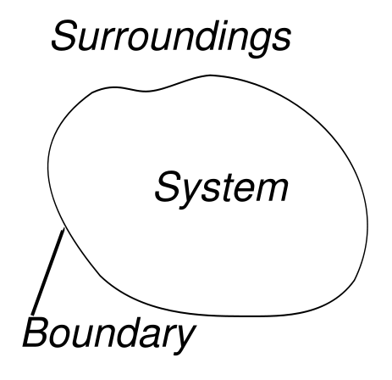
System
Boundary
V1.0
15-Abril 2011
Ferreiras.

Slide 2
System Scope
 Is deciding exactly what job we are trying to do in a given development effort;
 It is one of the most difficult part of a software project;
 It must be is the first step of the system team: Establish and obtain agreement on the scope and objectives of the system on study.

Slide 3
System boundary
Shows the scope of what a system will be. A system cannot have infinite functionality. So, it follows that use cases also need to have definitive limits defined.

Slide 4
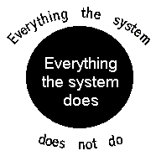

Slide 5
 The system boundaries should be a product of deliberate decision making. If we are no sure about system boundaries, we will have a difficult time deciding which are our core classes. ;
 .. ;
 .. ;

Slide 6
 A system boundary of a use case diagram defines the limits of the system.
 The system boundary is shown as a rectangle spanning all the use cases in the system.

Slide 7
For example, in most point-of-sale applications, there is both a customer and a clerk. First the customer sends a message to the clerk, and then the clerk sends a message to the system.
Question: Whom should be model as the actor, the customer or the clerk ?

Slide 8
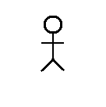
 If we consider the system as the point-of-sale terminal (the cash register), then the clerk is the one who interacts directly with the system:
Point-of-sale terminal
Buy Items
Clerk
System boundary at a point-of-sale terminal

Slide 9
 If we consider the store to be the system, the clerk is inside the system boundary, and the customer is the actor.
Point-of-sale terminal
Buy Items
Customer
System boundary at a retail store
( the clerk and point-of-sale terminal are inside)

Slide 10
 The more inclusive location for the system boundary is recommend. For example, the point-of-sale system could be implemented with automated checkout or the customer could be making a purchase using a web interface. These alternative implementations do not even have a clerk.

Slide 11
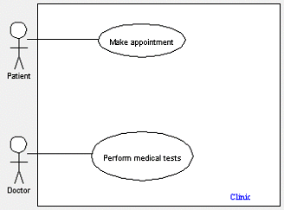
system boundary of the clinic application.

Slide 12
The figure shows the system boundary of the clinic application. The use cases of this system are enclosed in a rectangle. Note that the actors in the system are outside the system boundary.

Slide 13
The system boundary is potentially the entire system as defined in the problem statement. But this is not always the case. For large and complex systems, each of the modules may be the system boundary.

Slide 14
The System Boundary Model describes the system boundaries, the actors and their responsibilities, and the services offered by the system. Interactions between the system and its environment are identified and might also be detailed by modelling stimuli and responses using UML sequence diagrams.
Goals
From Requirements Model
http://www.modelbased.net/comet/requirements_modelling/3b_Requirements_model_html.html

Slide 15
Goals
The System Boundary Model should:
Identify and describe system boundaries, main services and actors.
Assure a common understanding of the system and its purpose.
Identify interactions between the system and its environment.

Slide 16
Methods and techniques
The starting point for the development of the System Boundary Model is provided by the System Concept Proposal -ff- [ Business Model work products, the Context Statement, Vision for Change, Business Process and Role Model and Business Resource Model.] Other important sources are the business stakeholders, who should be involved when determining the system boundary model.

Slide 17
To help in defining actors the following questions might be helpful to elaborate:
Who uses the system?
Who maintains the system?
What other systems use this system?
Who gets information from the system?
Who provides information to the system?
Does anything happen automatically at present time?
Who starts up and shuts down the system?

Slide 18
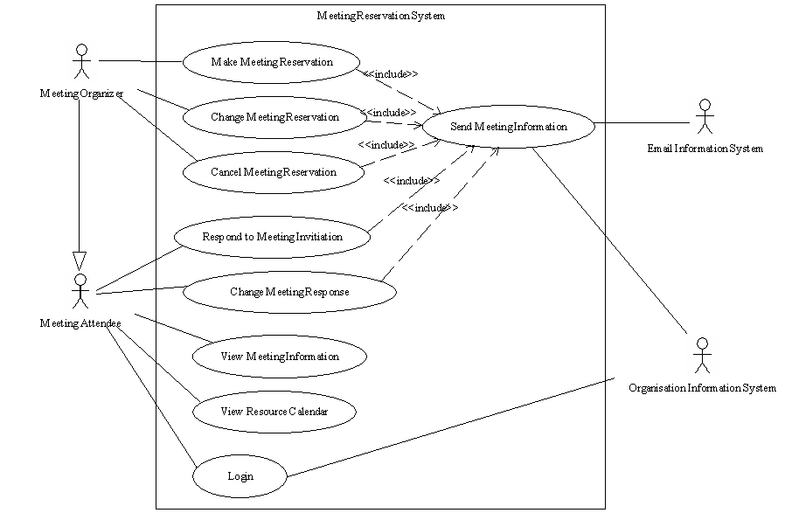
Figure 2: System Boundary Example – Meeting Room Example

Slide 19
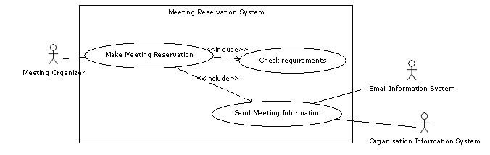

Slide 20
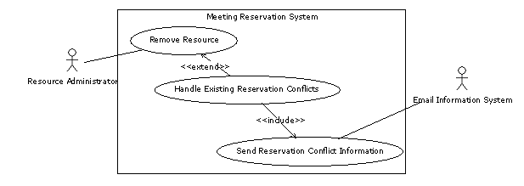

Slide 21
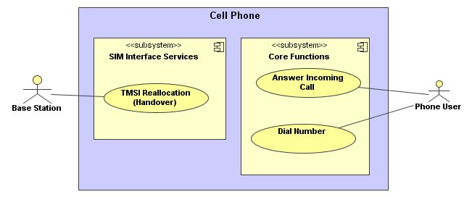

Slide 22
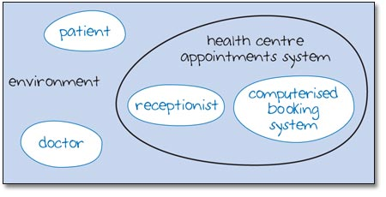
System map of a health centre appointments system, showing doctor and patient as part of the environment

Slide 23
Figure 4 illustrates yet another view of the health centre appointments system. Here the doctor and patient are seen as irrelevant and so do not appear at all in the system map. This view of an appointments system embodies yet another shift in emphasis. It is a view that might be taken by engineers who are concerned with the hardware and software of a computerized system (these are discussed in more detail in sections 8–14). However, this view is too narrow, and therefore risky, when designing new systems or planning enhancements to existing ones. Ignoring some of the users of the system or ‘stakeholders’ could lead to a booking system that doesn't do the job it was intended to do.

Slide 24
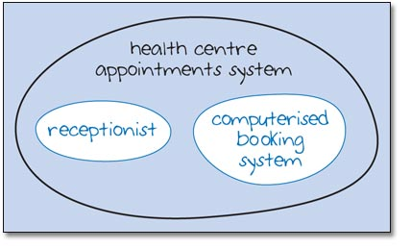
System map of a health centre appointments system, excluding doctor and patient

Slide 25
An email communication system includes:
the sender
the recipient
the sender's computer
the recipient's computer
the internet
Draw a system map to represent this email communication system (roughly oval outlines will be fine). Do you think the users (the sender and the recipient) should be inside the system boundary or outside it?

Slide 26
Figure 5 shows my system map. Where have you drawn the boundary? Does it include the sender and the recipient as the users of the system within the system boundary, or outside it? As you can see, I have drawn the users outside the system boundary, in the environment. Whether users of an email system feel outside or inside the system is an interesting question.

Slide 27
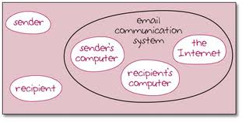
Figure 5: A system map of an email communication system

Slide 28
I've introduced system maps for two main reasons. Firstly, it is important to realise that systems are composed of subsystems and that these subsystems are often themselves composed of subsystems. This idea will help us as we explore ICT systems. Secondly, we may draw the system boundary in different places at different times. For example, if we want to discuss the social or economic impact of a particular ICT system, we will be drawing the boundary very widely indeed but if we want to look at how some subsystem in an ICT system works, then we will be drawing the boundary very tightly around the subsystem.
From:
http://openlearn.open.ac.uk/mod/oucontent/view.php?id=397533

Slide 29
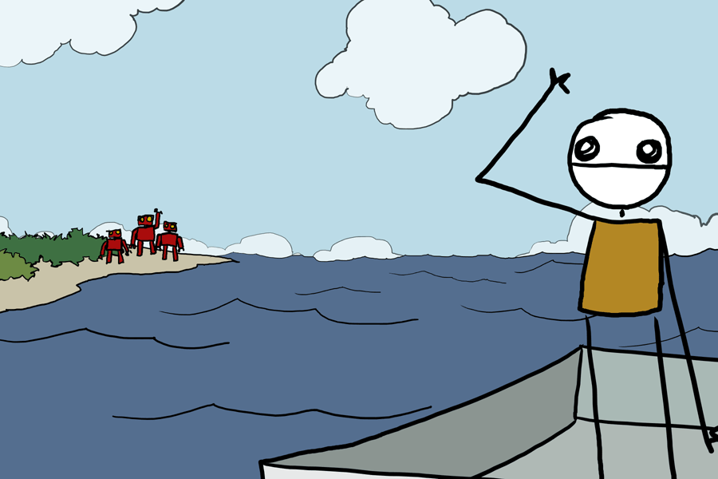
THANKS

